Slide 1




Regression with an Insurance Dataset
DAMO-510-4: Predictive Analytics (Winter 2025)
Presenters:
Denisse Cortes
Dev Rabadia
Miko Tan
Rosario Torres

Slide 2
Agenda
Project Overview
Methodology
Exploratory Data Analysis (EDA)
Data Preprocessing
Statistical Analysis & Tests
Model Development & Evaluation
Model Simulation
Q&A

Slide 3








Project Overview
Regression with an Insurance Dataset is part of Kaggle’s Playground Prediction Competition Series.
Project Objectives
Dataset Features
1
To predict insurance premiums using customer and policy data
Demographics | Age, Gender, Marital Status, Dependents, Education Level, Occupation, and Location
Health & Lifestyle | Health Score, Smoking Status, and Exercise Frequency
Financial & Credit | Annual Income, Credit Score
Vehicle & Property | Vehicle Age, Property Type
Insurance Policy | Policy Type, Insurance Duration, Previous Claims, Policy Start Date, Premium Amount, and Customer Feedback
2
To apply machine learning models to improve pricing accuracy and underwriting
3
To provide strategic insights for insurers

Slide 4




Methodology
Approach & Strategies for Predictive Analytics
Statistical
Analysis & Tests
Model
Development & Evaluation
Exploratory Data Analysis (EDA)
Data
Preprocessing
1
Descriptive Statistics
1
Handling Missing Data
1
Checking Data Distributions
1
Baseline & Advanced Models
2
Analyzing Missing Values
2
Feature Engineering & Transformation
2
Feature Selection
2
Hyperparameter Tuning
3
Identifying Outliers
3
Handling Outliers
3
Evaluation Metrics

Slide 5
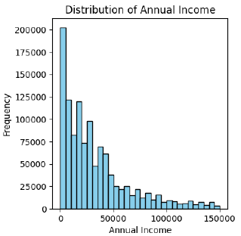
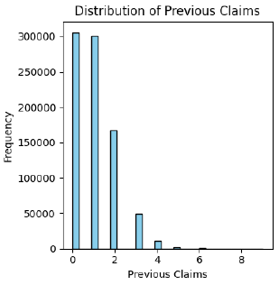
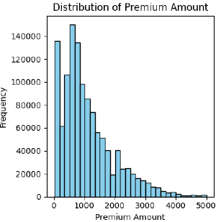
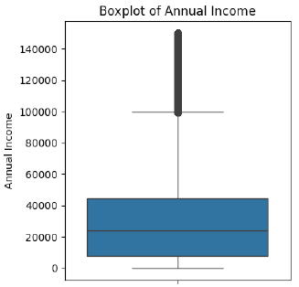
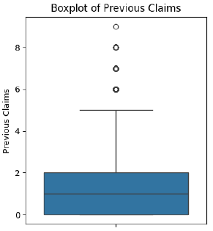
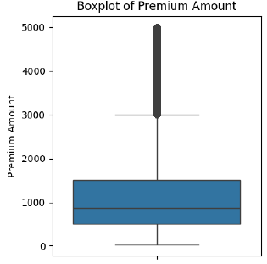
Exploratory Data Analysis (EDA) (1 of 3)
The process of examining, visualizing, and summarizing data to uncover patterns, trends, and insights before applying predictive models.
Annual Income, Previous Claims, and Premium Amount are the problematic features due to right skewness and outliers.
These issues will be handled during Data Preprocessing to improve model performance.

Slide 6
Exploratory Data Analysis (EDA) (2 of 3)
The process of examining, visualizing, and summarizing data to uncover patterns, trends, and insights before applying predictive models.
Category | Feature | Level of Measurement | Missingness | Skewness | Outliers
Demographics | Age | Ratio | 1.5% | Min/No Skew | -
 | Gender | Nominal | 0% | - | -
 | Marital Status | Nominal | 1.5% | - | -
 | Dependents | Ratio | 9.1% | Min/No Skew | -
 | Education | Ordinal | 0% | - | -
 | Occupation | Nominal | 29.8% | - | -
 | Location | Nominal | 0% | - | -
Health & Lifestyle | Health Score | Ordinal | 6.1% | Min/No Skew | -
 | Smoking Status | Nominal | 0% | - | -
 | Exercise Frequency | Ordinal | 0% | - | -
Financial & Credit | Annual Income | Ratio | 3.7% | Right-Skew (Box-Cox) | Yes
 | Credit Score | Interval | 11.5% | Min/No Skew | -
Note: Total Rows Processed = 1,200,000 Rows.

Slide 7
Exploratory Data Analysis (EDA) (3 of 3)
The process of examining, visualizing, and summarizing data to uncover patterns, trends, and insights before applying predictive models.
Category | Feature | Level of Measurement | Missingness | Skewness | Outliers
Vehicle & Property | Vehicle Age | Ratio | 0.0005% (6 Rows) | - | -
 | Property Type | Nominal | 0% | - | -
Insurance Policy | Policy Type | Ordinal | 0% | - | -
 | Insurance Duration | Ratio | 0.00008% (1 Row) | - | -
 | Previous Claims | Ratio | 30.34% | Right-Skew | Yes
 | Policy Start Date | Interval | 0% | - | -
 | Premium Amount | Ratio | 0% | Right-Skew | Yes
 | Customer Feedback | Ordinal | 6.49% | - | -
Note: Total Rows Processed = 1,200,000 Rows.

Slide 8
Data Preprocessing (1 of 2)
The process of cleaning, transforming, and organizing raw data to improve its quality and ensure accuracy for analysis and modeling.
Category | Feature | Missing Values Handling | Feature Engineering & Transformation | Outlier Handling | Other Handling
Demographics | Age | 1.5% (Drop) | Min/No Skew | - | Binning
 | Gender | 0% | - | - | One-Hot Encoding
 | Marital Status | 1.5% (Single) | - | - | One-Hot Encoding
 | Dependents | 9.1% (0) | Min/No Skew | - | Winsorization (10)
 | Education | 0% | - | - | Label Encoding
 | Occupation | 29.8% (Unemployed) | - | - | One-Hot Encoding
 | Location | 0% | - | - | One-Hot Encoding
Health & Lifestyle | Health Score | 6.1% (0) | Min/No Skew | - | -
 | Smoking Status | 0% | - | - | Label Encoding
 | Exercise Frequency | 0% | - | - | Label Encoding
Financial & Credit | Annual Income | 3.7% (Median) | Right-Skew (Box-Cox) | Binning | -
 | Credit Score | 11.5% (0) | Min/No Skew | - | -
Note: Total Rows Processed = 1,200,000 Rows.

Slide 9
Data Preprocessing (2 of 2)
The process of cleaning, transforming, and organizing raw data to improve its quality and ensure accuracy for analysis and modeling.
Category | Feature | Missing Values Handling | Feature Engineering & Transformation | Outlier Handling | Outlier Handling
Vehicle & Property | Vehicle Age | 6 Rows (0) | - | - | Winsorization (15)
 | Property Type | 0% | - | - | One-Hot Encoding
Insurance Policy | Policy Type | 0% | - | - | One-Hot Encoding
 | Insurance Duration | 1 Row (0) | - | - | Binning
 | Previous Claims | 30.34% (0) | Right-Skew (Box-Cox) | Binning | -
 | Policy Start Date | 0% | Temporal Patterns | - | -
 | Premium Amount | 0% | Right-Skew (Box-Cox) | Drop | -
 | Customer Feedback | 6.49% (Not Provided) | - | - | One-Hot Encoding
Note: Total Rows Processed = 1,200,000 Rows.

Slide 10
Statistical Analysis & Tests
The process of assessing data distributions, identifying correlations, and validating assumptions to enhance model accuracy and reliability.
Recursive Feature Elimination (RFE) finds the best feature set by repeatedly testing. It works well with any model.
The top selected features are highlighted below. Out of the 10 features, the group removed Customer Feedback_Not Provided as it did not make sense.
# | Feature | Rank
0 | Id | 27
1 | Age | 3
2 | Annual Income | 1
3 | Number of Dependents | 7
4 | Health Score | 20
5 | Previous Claims | 1
6 | Vehicle Age | 17
7 | Credit Score | 1
8 | Insurance Duration | 9
9 | Smoking Status | 14
10 | Age_Bin Numeric | 2
11 | Gender_Female | 26
# | Feature | Rank
12 | Gender_Male | 24
13 | Income_Bin Numeric | 1
14 | Education Level_Encoded | 13
15 | Occupation_Employed/Self-Employed | 8
16 | Occupation_Unemployed | 1
17 | Location_Rural | 11
18 | Location_Suburban | 18
19 | Location_Urban | 19
20 | Policy Type_Basic | 22
21 | Policy Type_Comprehensive | 23
22 | Policy Type_Premium | 15
23 | Policy Start Year | 1
# | Feature | Rank
24 | Policy Start Month | 1
25 | Years Since Start | 1
26 | Customer Feedback_Average | 4
27 | Customer Feedback_Good | 5
28 | Customer Feedback_Not Provided | 1
29 | Customer Feedback_Poor | 6
30 | Exercise Frequency Encoded | 12
31 | Property Type_Apartment | 25
32 | Property Type_Condo | 16
33 | Property Type_House | 21
34 | Previous Claims_Bin Numeric | 1
35 | Insurance Duration_Bin Numeric | 10

Slide 11


Model Development & Evaluation
The process of building predictive models, tuning parameters, and assessing performance to ensure accuracy and reliability.
Selected Features
Initial Model Run
Demographics | Occupation_Unemployed
Financial & Credit | Annual Income Income_Bin Numeric Credit Score
Insurance Policy | Policy Start Year Policy Start Month Years Since Start Previous Claims Previous Claims_Bin Numeric
Model | Training RMSLE | Test RMSLE
Linear Regression | 0.4714 | 0.4725
Decision Tree | 0.0057 | 0.6603
Random Forest | 0.4646 | 0.4659
XGBoost | 0.4641 | 0.4654
Model w/ RandomizedSearchCV
Model | Test RMSLE
Decision Tree | 0.4676
Random Forest | 0.4660
XGBoost | 0.4653
Key Observations:
RandomizedSearchCV improves RMSLE by efficiently tuning hyperparameters, reducing overfitting, and enhancing model generalization on skewed data.
The XGBoost model with RandomizedSearchCV performed best, demonstrating strong generalization and a low Root Mean Squared Logarithmic Error (RMSLE) using the test data.

Slide 12
Model Simulation
Bright Health Insurance Premium Prediction

Slide 13
Q&A

Slide 14
Appendix A: Detailed Model Results
Initial Model Run
Model | Training R-squared | Training RMSLE | Test R-squared | Test RMSLE | Brief Insights
Linear Regression | 0.0092 | 0.4714 | 0.0088 | 0.4725 | Poor Fit/Underfitting. Try more advanced models.
Decision Tree | 0.9999 | 0.0057 | -1.0028 | 0.6603 | Training Model Overfitting. Try Random Forest.
Random Forest | 0.0379 | 0.4646 | 0.0373 | 0.4659 | Poor Fit/Underfitting. Try Hyperparameter Tuning.
XGBoost | 0.0398 | 0.4641 | 0.0387 | 0.4654 | Requires tuning for more accurate predictions.
Model w/ RandomizedSearchCV
Model | Test R-squared | Test RMSLE | Brief Insights
Decision Tree | 0.0299 | 0.4676 | RMSLE indicates reasonable log-scale performance but R-squared suggests poor fit. Typically, an R-squared closer to 1 is desirable, so this indicates a poor fit.
Random Forest | 0.0370 | 0.4660 | A good model typically has R-squared > 0.7, meaning this Random Forest model is not learning strong patterns from the data. RMSLE improvement is minimal.
XGBoost | 0.0393 | 0.4653 | R-squared and RMSLE is slightly better than other models. However, still requires further improvement on feature engineering to improve R-squared.
Notes:
Multiple Linear Regression Model Results:
Training Data: Mean Squared Error (MSE): 184.91 (relatively high), R-squared: 0.0092 (very low), RMSLE: 0.4714 (moderately low)
Testing Data: Mean Squared Error (MSE): 185.30 (slightly higher than training data), R-squared: 0.0088 (almost identical to training data, still very low), RMSLE: 0.4725 (similar to training data)
Insights:
Poor Fit (Low R-squared): The R-squared value of 0.009 (for both training and testing) indicates that the model is not capturing the relationship between the features and the target variable well at all. Essentially, this means that the model explains only about 0.92% of the variance in the target variable, which is very poor for a linear regression model. An R-squared value so close to 0 suggests that the features might not be strongly related to the target, or the model is underfitting, which occurs when the model is too simple for the complexity of the data.
High MSE: Both the training and testing MSE are relatively high (around 185), which further suggests that the model is not making accurate predictions. The small difference between training and testing MSE (185.30 vs 184.91) indicates that the model is not significantly overfitting or underfitting but is consistently poor across both sets. This implies that the model isn't capturing patterns effectively on either set.
Similar RMSLE (Training vs Testing): The RMSLE value is very close between training and testing sets, which indicates that the model's performance is similarly poor across both sets. While the RMSLE is moderate, it suggests that there are significant discrepancies in predictions even on a logarithmic scale, meaning the model isn't effectively predicting smaller values relative to the actual data.
Conclusion: The linear regression model is not performing well on both the training and testing datasets, indicating underfitting. To improve performance, you should try more complex models, feature engineering, or regularized regression techniques, and examine the data for any issues.
Decision Tree Model Results:
Training Data: MSE: 0.0258 (very low), R-squared: 0.9999 (almost perfect fit), RMSLE: 0.0057 (very low)
Testing Data: MSE: 374.416 (very high). R-squared: -1.0028 (negative, indicating a very poor fit). RMSLE: 0.6603 (much higher than the training data)
Insights:
Overfitting: The Decision Tree model is likely overfitting the training data. A training R-squared of 0.9999 means the model has almost perfectly learned the training data, which is a typical sign of overfitting in Decision Trees. Overfitting occurs when the model captures not just the underlying patterns but also the noise in the training data, making it less generalizable to unseen (test) data.
High Testing MSE & Negative R-squared: A high MSE and negative R-squared on the test set are signs that the model is not generalizing well. In fact, negative R-squared values indicate that the model performs worse than a simple mean-based model (i.e., predicting the mean value for all observations). MSE of 374.416 suggests a large error between predicted and actual values on the test set, which is much worse than the performance on the training set.
High Testing RMSLE: The testing RMSLE of 0.6603 is significantly higher than the training RMSLE of 0.0057, further supporting that the model is unable to generalize well to the test data. This indicates that the model is making poor predictions on the test set compared to the training set.
Possible Solutions: Pruning the Decision Tree, Cross-Validation, Random Forest, Feature Engineering, Hyperparameter Tuning
Random Forest Model Results:
Training Data: Mean Squared Error (MSE): 179.55, R-squared: 0.0379, RMSLE: 0.4646
Testing Data: Mean Squared Error (MSE): 179.98, R-squared: 0.0373, RMSLE: 0.4659
Insights:
Poor Fit (Low R-squared): The R-squared value for both training and testing datasets is very low (around 0.0379 for training and 0.0373 for testing). This indicates that the model is explaining very little of the variance in the target variable. Specifically, the model is explaining only about 3.79% of the variance in the target during training and 3.73% during testing, which is very poor performance. Random Forests are generally robust models, but these results suggest that there might be issues with the data or the model configuration that are preventing it from learning meaningful patterns.
MSE Analysis: The MSE for both the training (179.55) and testing (179.98) datasets is quite close. This indicates that the model is not overfitting, since the model's error on the training data is nearly the same as the error on the testing data. However, the high MSE in both datasets indicates that the model is still making large prediction errors, which further suggests that the model is not learning well from the data.
RMSLE Analysis: The RMSLE value is very similar between the training and testing datasets (0.4646 vs 0.4659), indicating that the model's performance is consistent across both sets. The RMSLE values are relatively low, suggesting that the model's predictions are not far from the actual values on a logarithmic scale, but this is still not sufficient for a good model. The RMSLE is a better metric for models that deal with skewed data, and it suggests that while the model is performing moderately well, it still has room for improvement.
Conclusion: The Random Forest model shows poor performance with low R-squared values and high MSE. The model is underfitting the data, which can be addressed by tuning hyperparameters, increasing model complexity, and improving the feature set. Data issues, like missing values or poor feature selection, should also be examined to improve the model's performance.
XGBoost Model Results:
Training Data: Mean Squared Error (MSE): 179.20, R-squared: 0.0398, RMSLE: 0.4641
Testing Data: Mean Squared Error (MSE): 179.71, R-squared: 0.0387, RMSLE: 0.4654
Insights:
Poor Fit (Low R-squared): The R-squared value for both training and testing datasets is very low (around 0.0398 for training and 0.0387 for testing). This suggests that the model is explaining only about 3.98% of the variance in the target during training and 3.87% during testing. While XGBoost is known for performing well with complex data, these results indicate that the model is not capturing useful patterns or relationships in the data.
MSE Analysis: The MSE values for both training (179.20) and testing (179.71) datasets are close to each other, which indicates that the model is not overfitting. This suggests that the model is making similar errors on both the training and testing datasets. However, the relatively high MSE values indicate that the model is still struggling with accurately predicting the target variable.
RMSLE Analysis: The RMSLE values for training (0.4641) and testing (0.4654) datasets are very similar. This shows that the model is performing consistently on both datasets, which further supports the idea that the model is not overfitting. The RMSLE value indicates that while the model's predictions are somewhat close to the actual values in a logarithmic scale, it still needs improvement to provide more accurate predictions.
Decision Tree Model – RandomizedSearchCV Results:
Insights:
R-squared (0.0299) is very low: The model explains only ~3% of the variance in the target variable, which suggests that the Decision Tree is not capturing meaningful patterns in the data. Typically, an R² closer to 1 is desirable, so this indicates a poor fit.
RMSE (13.467) suggests high prediction errors: RMSE measures absolute error magnitude. The higher the value, the worse the model performs in predicting the target variable. Since RMSE is not close to zero, this indicates that the model struggles with accurate predictions.
RMSLE (0.4676) is moderate: RMSLE penalizes large under-predictions more than over-predictions. A value below 0.5 generally indicates reasonable log-scale performance, but since R² is so low, this doesn’t mean the model is good.
Random Forest Model – RandomizedSearchCV Results:
Insights:
R-squared (0.0370) is still very low: The model explains only ~3.7% of the variance in the target variable, which is slightly better than the Decision Tree (0.0299) but still poor. A good model typically has R² > 0.7, meaning this Random Forest model is not learning strong patterns from the data.
RMSE (13.417) is high: The magnitude of errors is almost the same as the Decision Tree (13.467). This suggests Random Forest is not significantly improving performance over Decision Tree.
RMSLE (0.4660) is slightly lower than Decision Tree (0.4676): Since RMSLE is on a log scale, the difference is small. A lower RMSLE means that the model slightly reduces large under-predictions, but the improvement is minimal.
XGBoost Model – RandomizedSearchCV Results:
Insights:
R-squared (0.0393) is still very low: The model explains only ~3.93% of the variance in the target variable. While this is slightly better than Random Forest (0.0370) and Decision Tree (0.0299), it is still too low to be considered a good model.
RMSE (13.401) is slightly lower than other models: Compared to Random Forest (13.417) and Decision Tree (13.467), XGBoost achieves the lowest RMSE. This means XGBoost has slightly lower prediction errors, but the improvement is not significant.
RMSLE (0.4653) is slightly lower than other models: Compared to Random Forest (0.4660) and Decision Tree (0.4676), XGBoost achieves the best RMSLE. Since RMSLE penalizes under-predictions, this suggests XGBoost is slightly better at handling small values.

